Slide 1


For Love or Money?
How to generate high revenue from a team of R developers
Dr Lisa Clark
Principal Data Science Manager
Virgin Media | Public

Slide 2

The tension between fun and value?
£
A misnomer!
I will show this does not have to be the case using:
Experience
Examples
Use it to influence upwards, sideways and/or downwards!
versus
Programmers / data scientists
Business
versus
Virgin Media | Public

Slide 3

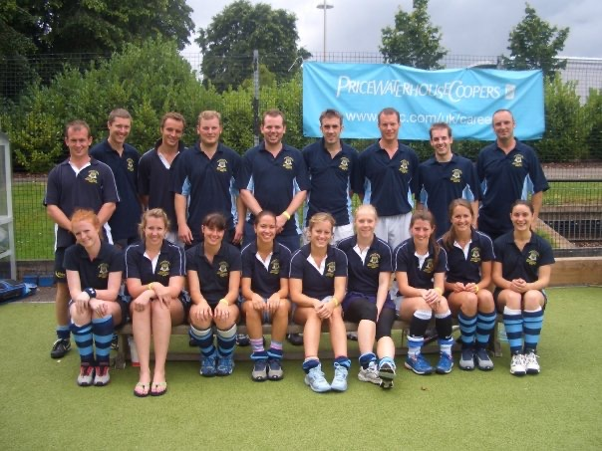
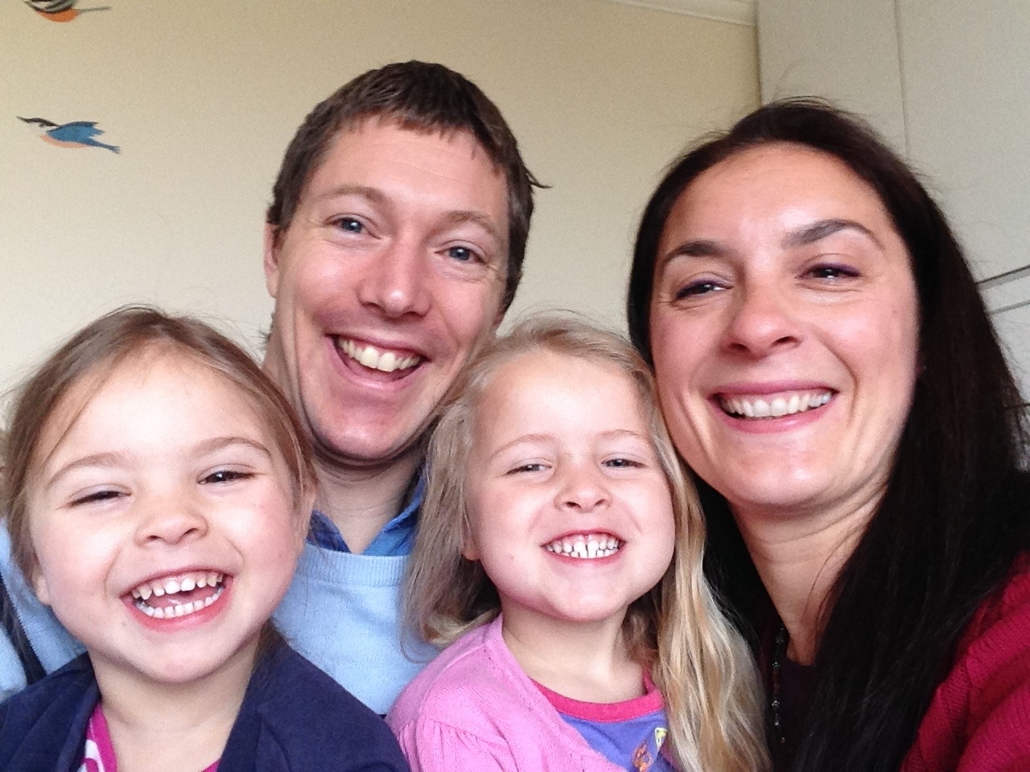
It’s just me, me, me…
MPhys Physics with Nuclear Astrophysics
PhD Theoretical Physics (Cosmology)
Postdoc in Cosmology
Data
Programming
Analysis
Business Reqs
Working at the Sheffield Solar Farm, The University of Sheffield
Founded and ran 3 companies
Research Fellow
Solar Panels
Renewable Energy
Economic Policy Analyst
Data Scientist
Principal Data Science Manager at VM
Virgin Media | Public

Slide 4





Virgin Media at a glance…
One of the world’s leading converged video, broadband and communication companies
14.9m
homes passed
3.1m
mobile customers
45k*
businesses served
5.9m
cable customers
*This doesn't include our SoHo customers in the UK and Ireland
Virgin Media | Public

Slide 5


My experience…
…of leading analytical teams
Business
Demands ROI…but how should VALUE be determined?
Often wants quick solutions
Views skilled analysts and data scientists as an expensive resource
Doesn’t always understand “AI”
Managers
Can struggle to define the “right” projects and priorities
Are stuck between delivering high value and maintaining an engaged team
Can find it difficult to engage a team of (mainly) introverts
Data Scientists
Want to develop exciting code
Want to learn new tricks
Hate too much data engineering!
Data science projects aren’t quick!
Virgin Media | Public

Slide 6
What makes a programmer happy?
A computer (of their choice)
High Speed Internet
A problem to solve
An empty room!
Virgin Media | Public

Slide 7


What tricks have I learned to get my team engaged?
Managers need to know all the individual personalities and their irritation points
For me personally: Listen more!
“Capability Building” = Provide Learning & Development opportunities
Give a data science team space and time with the right tools
Use the correct tools & remove IT barriers
Fewer meetings!
Design the environment to feel more academic
Initiate “Lunch & Learn” sessions
During Covid19: games sessions during work hours!
Virgin Media | Public

Slide 8






Definition of value?
Value is in the eye of the beholder
Are these measureable?
Quality
Sales
Advocacy
Capability building?
Costs
Computing efficiency?
“Business as usual”?
Virgin Media | Public

Slide 9
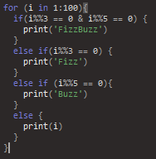
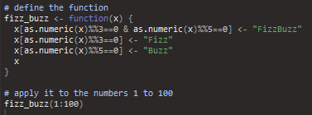
Tension between code and ROI
When is code “good enough”?
Quick solution
Possibly a little “dirty”
Does the job!
Use of a function might be better for production code
Easier for others to understand (possibly)
Scalable
Does the job!
Virgin Media | Public

Slide 10

So how to obtain value and make it fun?
The “right” projects
Environmental set-up
Integrate all aspects above into day to day project work!
Learning & Development
Capability build
Virgin Media | Public

Slide 11
The Knapsack Algorithm
Case Study
Virgin Media | Public

Slide 12








Capital Expenditure Optimisation
The knapsack problem
Requirement:
Maximise the revenue from projects whilst keeping within Capital Expenditure (CAPEX) budget
Each project has a given installation cost and associated revenue
Business question:
Apply a simple threshold for each project
Above this threshold, projects might be cancelled
What would be the best threshold?
Not all projects can be implemented within CAPEX budget so need to prioritise
Virgin Media | Public

Slide 13
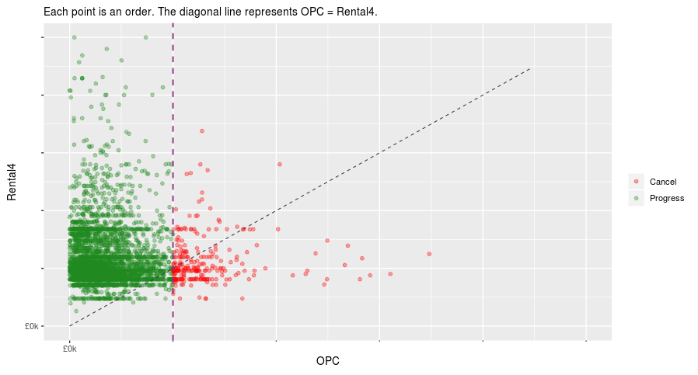
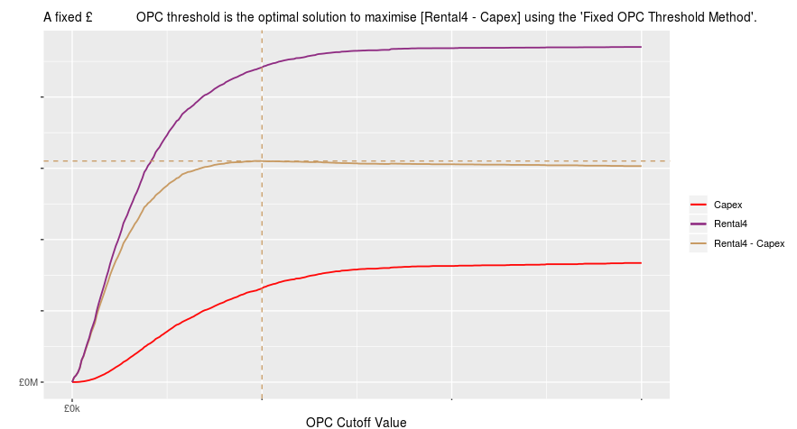
Simple CAPEX threshold
Some “profitable” projects are excluded!
Threshold defined by plateau
But loss making projects are still allowed!
Virgin Media | Public

Slide 14
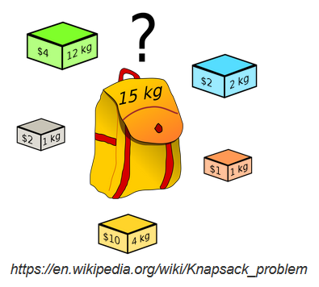
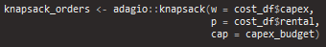
Knapsack Model
Using the Adagio package
The knapsack problem or rucksack problem is a problem in combinatorial optimization.
Given a set of items with a given size/weight and value, determine which items should be included in a collection in order to maximise the value by utilising the greatest total size/weight.
Given a set of projects with known CAPEX costs, maximise the Rental for a given CAPEX budget:
Virgin Media | Public

Slide 15
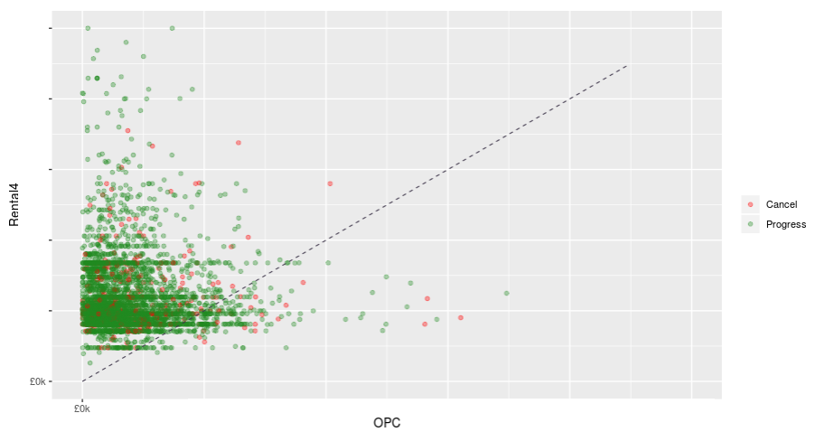
Knapsack Model Result
Using the Adagio package
Provides an upper limit to the potential “profit” given a set CAPEX limit
9.5% of projects cancelled
only 92 fewer projects vs. simple threshold
£1.5M “profit” gain keeping within CAPEX
£0.2M gain over simple threshold model
Virgin Media | Public

Slide 16
Clustering with CLARA
Case Study
Virgin Media | Public

Slide 17





Customer segmentation
Clustering problem
Requirement:
Identify groups of business customers who are alike in their characteristics
Use a holistic (non-human) approach to avoid human-led bias
Business question:
Can we enhance our understanding of customers and their wants/needs
Enable us to focus marketing campaigns towards specific customer groups
Allow the computer to learn similarities between customers not otherwise identified
Virgin Media | Public

Slide 18
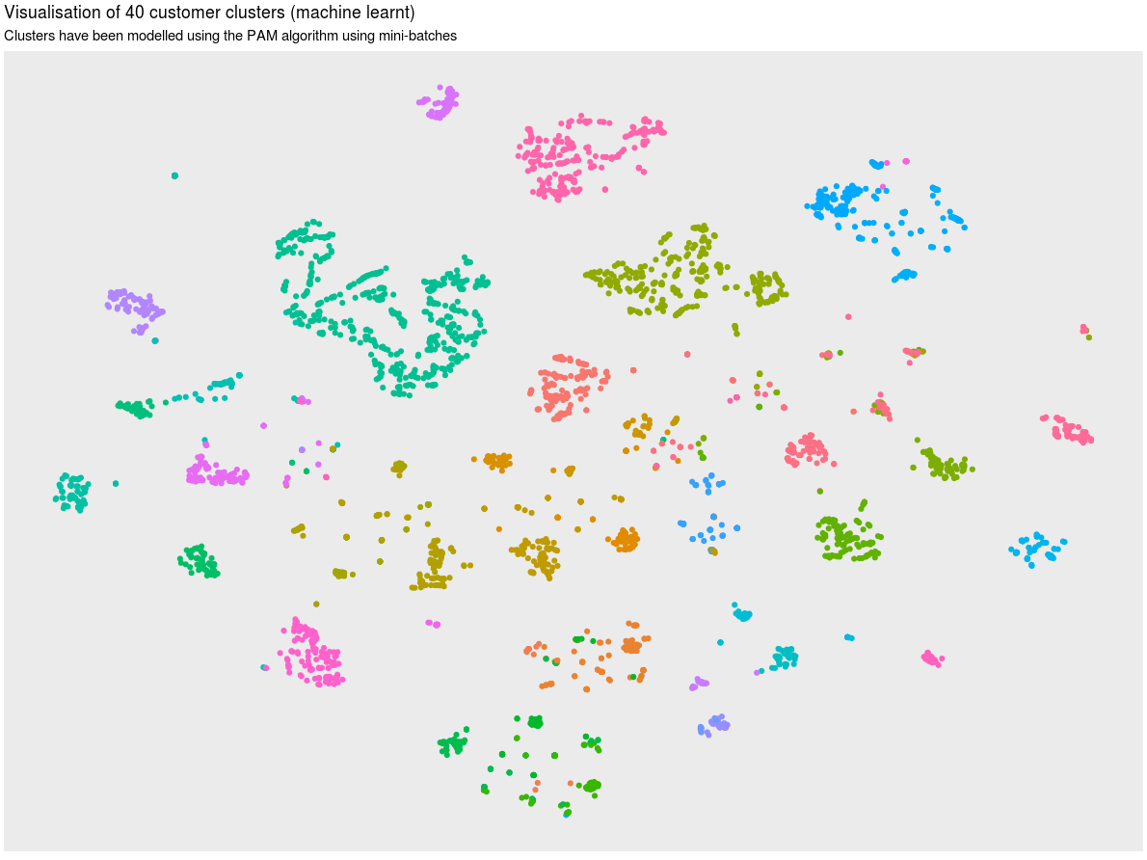
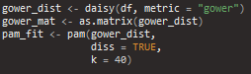
Clusters: most relevant characteristics
Using packages: cluster & Rtsne
££ gained in high revenue marketing campaigns
Compare between clusters
Model run with 40 clusters
19 features
Used Gower distance to account for non-numeric features
Due to the large number of customers, we also developed a bespoke CLARA algorithm for clustering
Compare within clusters
Slide 18
Virgin Media | Public

Slide 19
Visualisation
Case Study
Virgin Media | Public

Slide 20
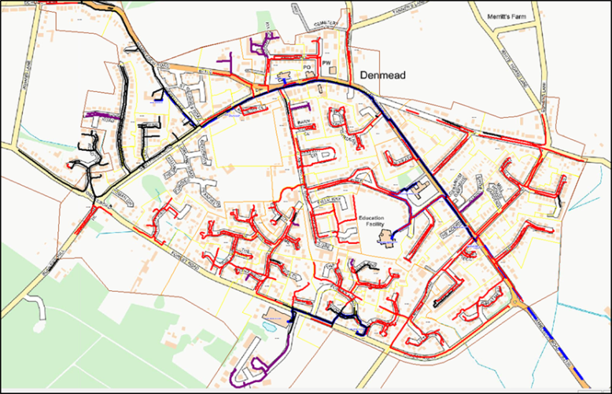
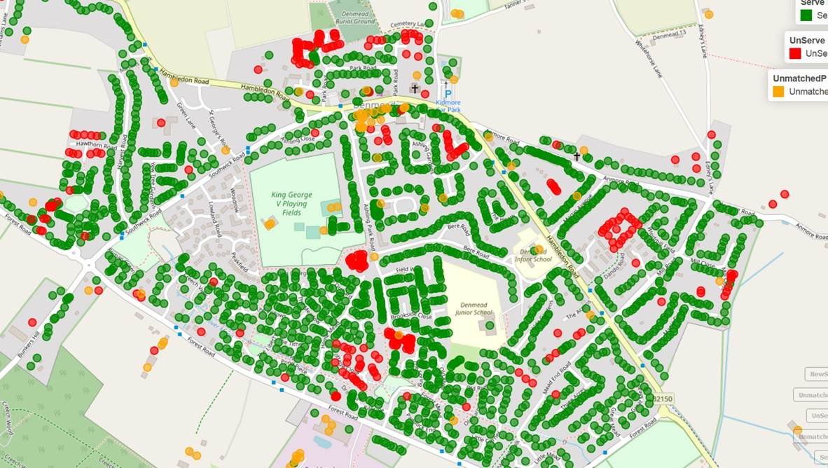
Presenting a message quickly
* Serviceable = if a premise can be serviced with VM products
Using Leaflet (and Shiny) for premise serviceability
Visually displaying serviceability on a map
Quick to identify live network
Visible premise serviceability
Identification of “unusual” listings
Identification of business clusters
Virgin Media | Public

Slide 21

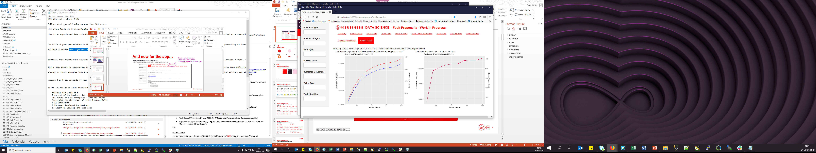
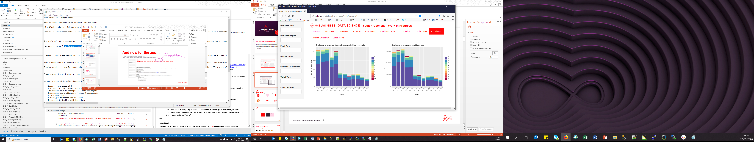
Using Shiny…
Successfully used for network fault analysis
A good clear way of presenting dynamic data to non-analysts quickly
Adding value doesn’t always have to be complex!
Virgin Media | Public

Slide 22





Achieve high revenue gains by motivating the real asset: The programmers!
Give a data science team space and time with the right tools
DAY TO DAY
Virgin Media | Public

Slide 23
Thank you!
Dr Lisa Clark
Principal Data Science Manager
Lisa.clark3@virginmedia.co.uk
Virgin Media | Public

